Slide 1
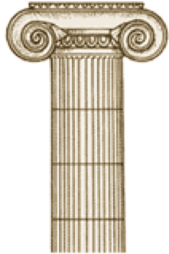
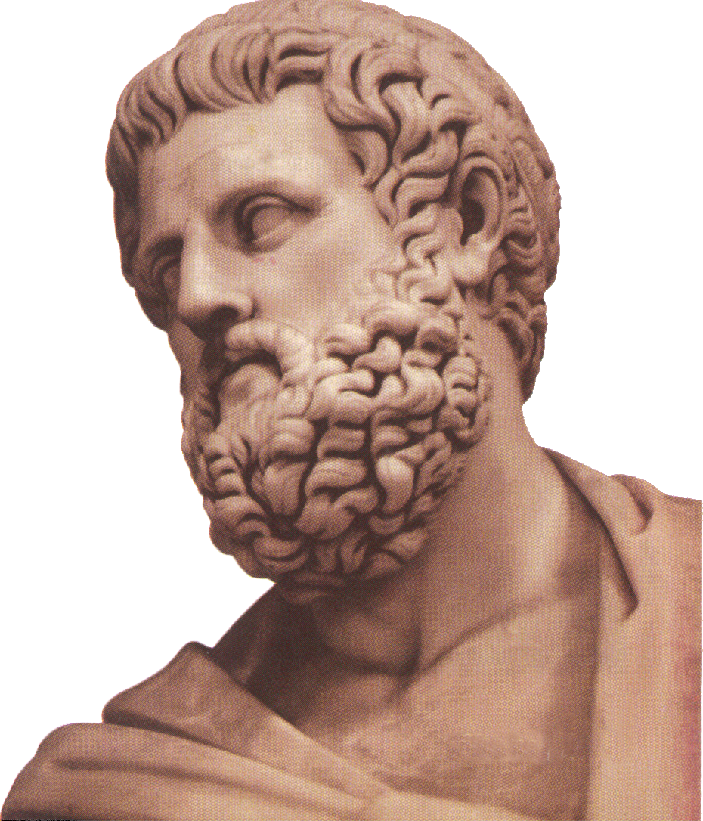
Somatic Analysis
of Attic Greek Drama
Sociolinguistic Differences Among Speaker Groups
Phillip Barnett
Taha Husain
A corpus and usage-based approach to Ancient Greek: from the Archaic period to Koiné
Riga 2018

Slide 2
How do speakers identify themselves? (Eckert 1989)
People index themselves as members of various social groups through a variety of indices including appearance, mannerisms, and language.
Speakers are often aware of social groupings.
Persona styles encourage variation

Slide 3
Historical Sociolinguistics (Nevalainen & Raumolin-Brunberg 2017:2)
Language change is thought to have social origins
A synchronic look at the sociolinguistic situation of an historical context is therefore important for understanding language change.
In addition, it answers all the same questions as standard sociolinguistics

Slide 4
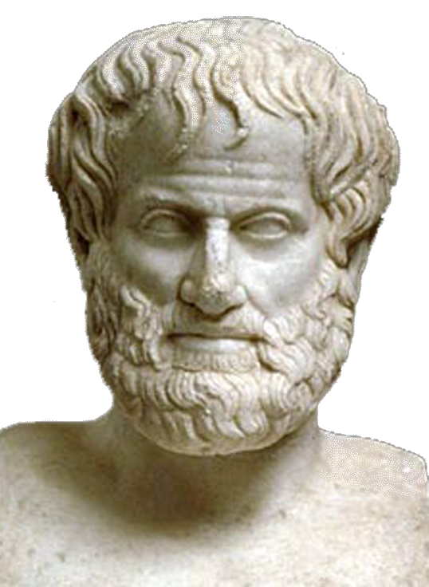
What are we doing?
We created a corpus of Attic Greek plays tagged for speaker metadata
We queried this corpus which features are the most highly correlated for different speaker groups’ persona styles

Slide 5
Why Plays?
Historical sociolinguistics often lacks candid variety of speaker groups
Plays provide dialogue that is (often) intended to be representative of actual speech
While not a perfect analog to recorded conversation, play dialogue is the closest we have for the distant past

Slide 6
Our corpus
ALL of the Complete Attic Greek Plays
5 Authors
47 Plays
854,166 Tokens
228,847 Types
3.7325 IDF
Uses Greek beta code:
τί δῆτα τόξων ἔργον, εἰ δίκην ἔχεις;
ti/ dh=ta to/cwn e)/rgon, ei) di/khn e)/xeis;

Slide 7
Our Metadata Tags
We tagged the entire corpus for what we know about the speaker.
A line/block of dialogue looks like this:
<SP N="*)apo/llwn" G="M" S="G" E="D">
qa/rsei: di/khn toi kai\ lo/gous kednou\s e)/xw.
</SP>

Slide 8
Problems With Tagging
Unique edge cases
Non-human characters
Sparse information
Hand tagging

Slide 9
Noteworthy Tags
E="A" E="BO" E="M" E="TH"
G="F" G="M"
S="C" S="G” S="R" S="S"
N="xoros"
Greeks & Non-greeks

Slide 10
Why those groups?
To our knowledge, there is no concrete list of linguistically interesting speaker groups.
Based on our familiarity with Ancient Greek plays, we came up with:
Age
Gender
Social Class
Ethnicity/Geographic Origin

Slide 11
Ancient Greek Society
Greek pecking order:
Gods
Royalty
Commoners
Servants/slaves
Heavily patriarchal
Athenians held other ethnicities in low regard
Is there evidence to suggest that speakers use particles to index prestige?

Slide 12
Particles
δε - “well, however, on the one hand, but”
δη - adds emphasis or specificity
γε - “at least, only”
μεν - used only in specific expressions
μην - “verily, truly”
Other particles were not found to have any special significance

Slide 13
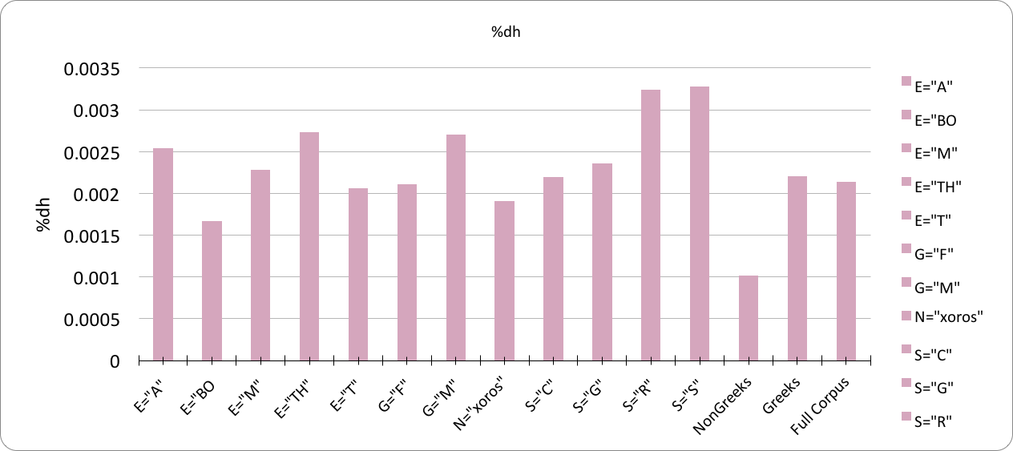
δη - adds emphasis or specificity

Slide 14
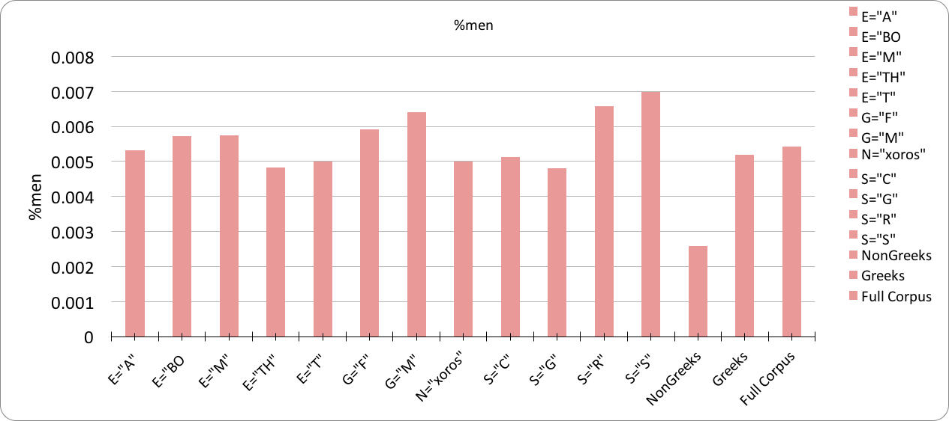
μεν - used only in specific expressions

Slide 15
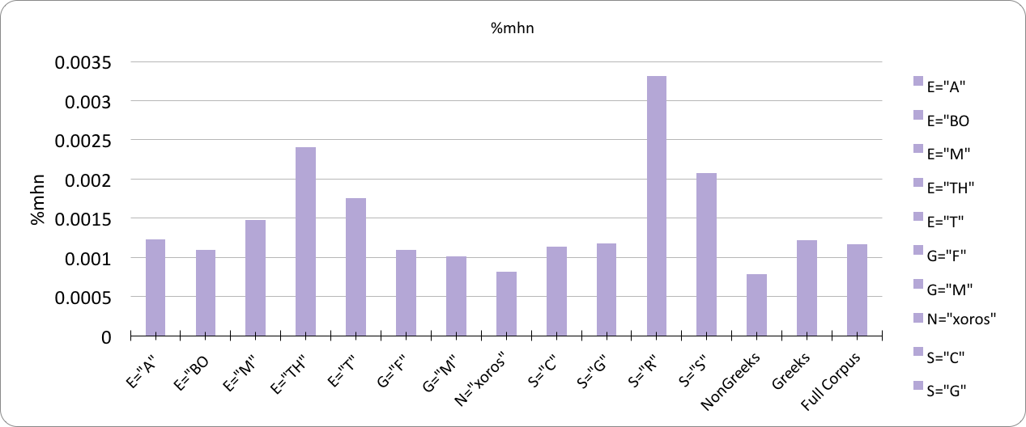
μην - “verily, truly”

Slide 16
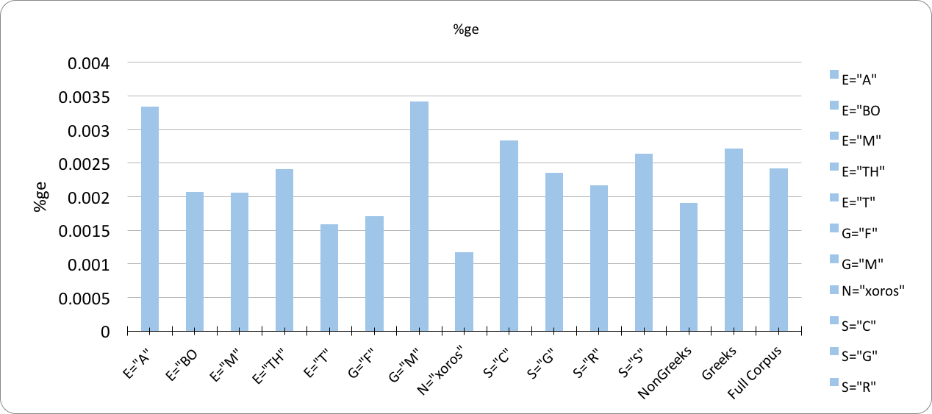
γε - “at least, only”

Slide 17
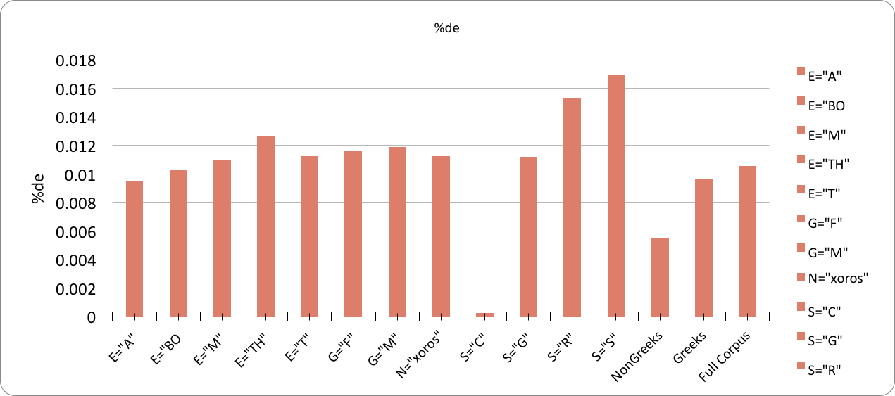
δε - “well, however, on the one hand, but”

Slide 18
Discussion
δη and μεν were used less by non-Greeks
Clear disfluency marker, shared by class?
μην used more by royalty and servants
Used more by Trojans than Greeks, but non-Greeks use it less overall
The Trojan Women
μεν and δε are often used together; less common formality marker?
γε was used more by Athenians and males
δε is barely used by commoners, the most by servants, followed by royalty and gods
Class Aspiration (Labov 1966:66)

Slide 19
Discussion
While this data is preliminary, we can make some braid conclusions:
δη - fluency marker
μεν - possible fluency marker
μην - class marker
γε - gender & in-group marker
δε - formality marker

Slide 20
Future Study
Language change
Literary insight
What groups are socially relevant?
Genre differences
Expand to different gneres, regions, and time periods
Compare to different cultures of theatre
Suggestions?

Slide 21
References
Crespo, E.-Conti, L.-Maquieira, H. (2003). Sintaxis del griego clásico, Madrid. Denniston, J. D. (19542). The Greek Particles, Oxford
Bakker, Stephanie; Wakker, Jerry. Discourse Cohesion in Ancient Greek.
Eckert, P. (1989). Jocks and burnouts: Social categories and identity in the high school. New York: Teachers College Press.
Eckert, P., & Rickford, J. R. (eds.) (2002). Style and Sociolinguistic Variation. Cambridge: Cambridge University Press
Labov, William (1966). The Social Stratification of English in New York City. Cambridge: Cambridge University Press. p. 66.
Nevalainen & Raumolin-Brunberg. (2017). Historical Sociolinguistics: Language Change in Tudor and Stuart England. Routledge, London.
Soltic, Jorie. (2013). Greek, Roman, and Byzantine Studies 53 390–419.
The Phonology of a North Indian Village Dialect. Indian Linguistics 16: 283-295.

